Slide 1
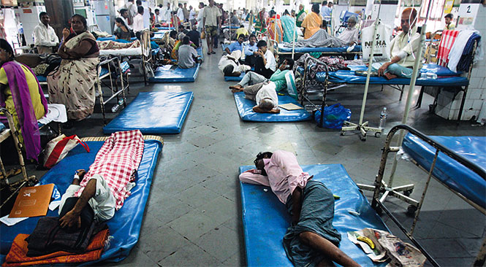
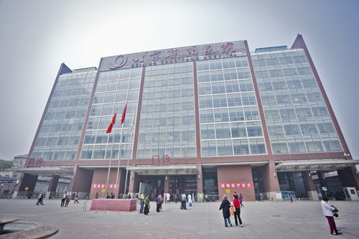
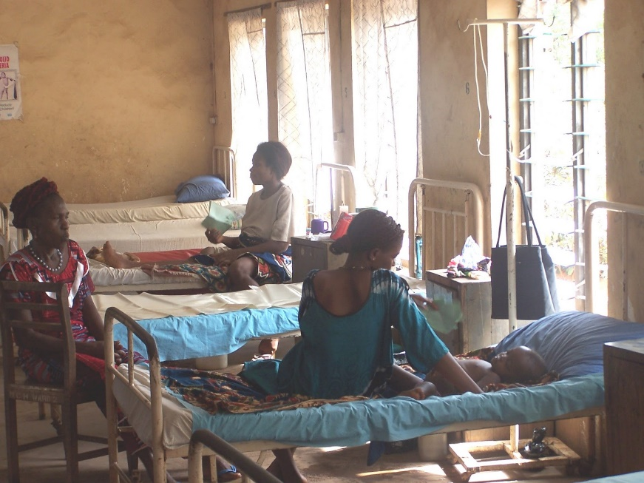
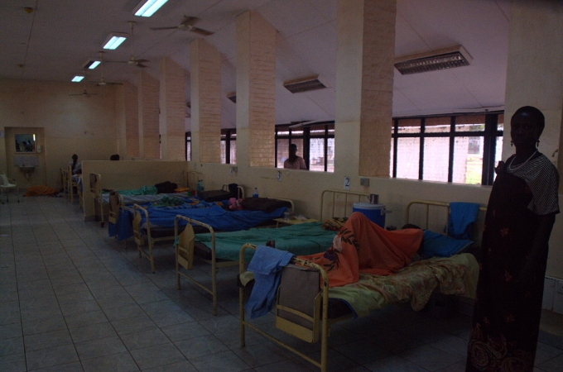
This image resembles the terrors of over populated hospitals.
It also shows the issues with hospitals not being funded enough for the building size for more patience to come in.
This is an image of a wealthy countries hospitals which have the capabilities to hold a larger number of patience.
The above image shows the real trouble is poverty conflicted countries across the globe.
Not being enough medicins
Not having any room
Pateince often left on the side or walk through areas.
Deaths happening throughout the globe every minute of the day.

